Slide 1


CETIN POC

Slide 2
Wipro – UC 6: Service availability check
CETIN CZ POC
Preconditions:
Existing POP-Sites (OLT, DSLAM and 5G) with geo-coordinates in FNT Command
Input parameters:
New customer site with geo-coordinates
Search radius
Procedure:
Search POPs within radius (Math formula)
For each found POP query related NE (OLT, DSLAM)
For each NE query rest uplink bandwidth
Output:
List available of POPs
For each POP – available technology and rest bandwidth

Slide 3
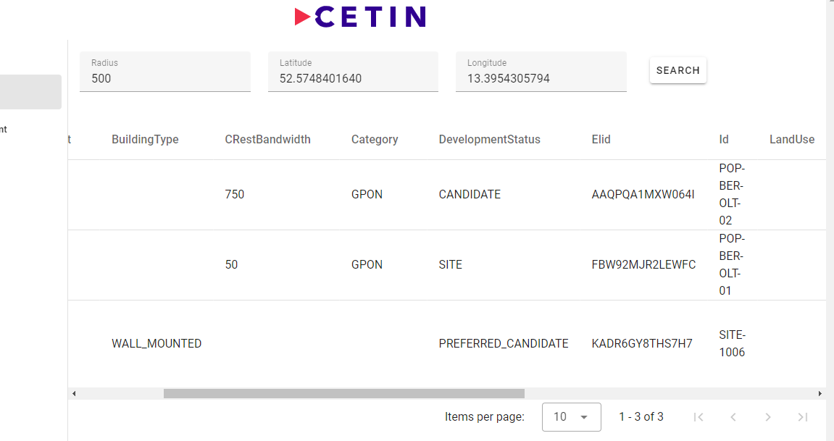
Listing all the available site/POP’s based on provided radius and geo co-ordinates.
UC-6 Automatic Service Availability Check

Slide 4
Wipro – UC 4: Service decomposition
CETIN CZ POC
Preconditions:
Existing GPON services in FNT Command
Input parameters:
Node
Cable
…
Procedure:
Query Telco hierarchy for given input
Highlight end customer services (S), infrastructure services (I) and neighboring nodes (N)
Output:
List of impacted services (S),(I),(N)

Slide 5
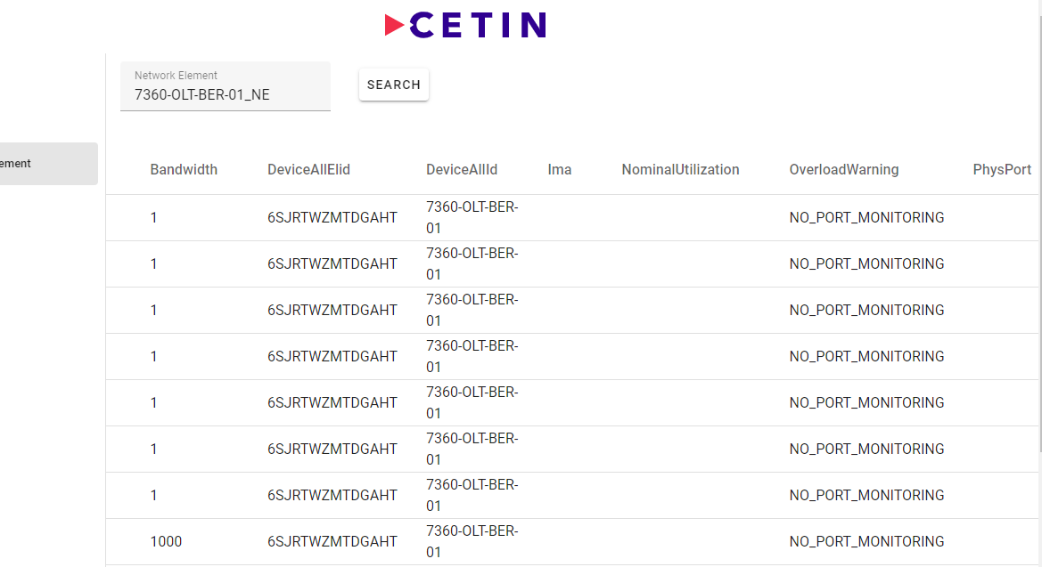
Listing all the impacted service and neighbouring nodes for identified network element.
UC-4 Service Decomposition

Slide 6
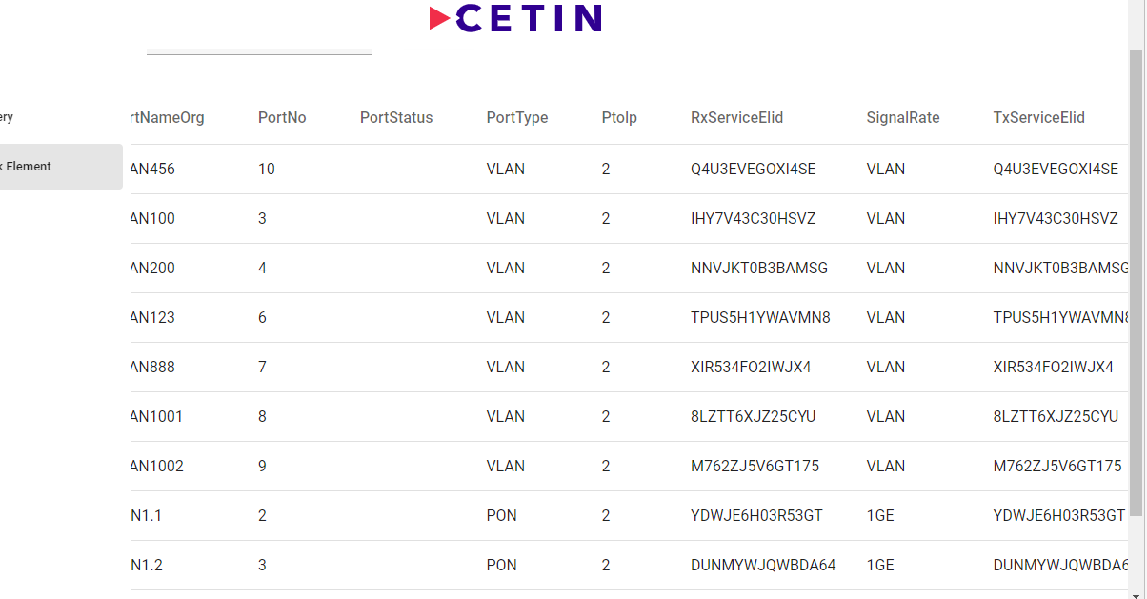
Cont.

Slide 7
Thank You

